Slide 1


OptiNor
Sound-reducing Floor System

Slide 2
OptiNor
Sound-reducing Floor System
Resume of my professional experience and development history
Since 1999 I have represented Swedish factories in Norway in the field of adjustable sound-reducing floor systems.
I have sold over 500,000m2 and the Norwegian government's ViP hotel in Inkognitogata in Oslo ranks as my highest prestige project.
In the period until 2017, I had projects all over the Norway from the south to the north, as well as countless courses and presentations regarding the building traditions of ;
Contractors, Architects, Acousticians and Builders, both governmental and private.

Slide 3
OptiNor
Sound-reducing Floor System
Resume of my professional experience and development history
From 2017 until today, I have concentrated on developing new products.
After a long period of development and testing, with a pandemic in between, I have come up with today's product.
During this time, I have also developed a good relationship with the Technical Manager at Norgips Norway AS.
I have also found quality manufacturers in Sweden, who will produce the various parts of the system.

Slide 4
OptiNor
Sound-reducing Floor System
What are the elements behind the product?
Through acquired expertise over many years, I have a strong sense of the qualities that a height-adjustable sound-reducing floor system should have.
The system will meet the current C-requirements in Norway and Sweden by a good margin
The system should also be optimal for installation
The system will solve the entry heights of the various floors
The system must comply with environmental concerns and requirements

Slide 5
OptiNor
Sound-reducing Floor System
Benefits of installation
The system solves the need for CC distance regulation in a simple way, which solves various assembly challenges
The system is designed for double compressive loads per m2
The system's sound-reducing screws allow the joist to be self-standing during assembly
There is no need for cutting the excess screw
The sum of the benefits results in faster installation and increased profits

Slide 6
OptiNor
Sound-reducing Floor System
Facts
The best height-adjustable sound-reducing floor system on the market
Test winner based on SINTEF report
Best in installation – flexible, high load capacity, quick installation

Slide 7
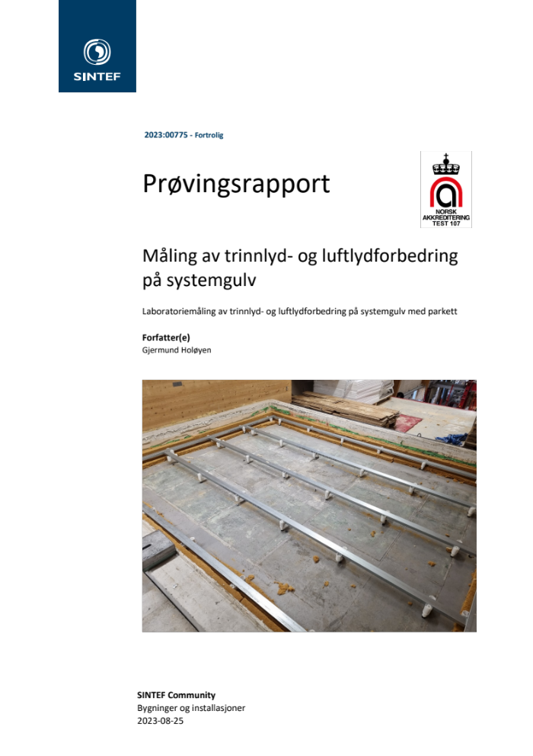
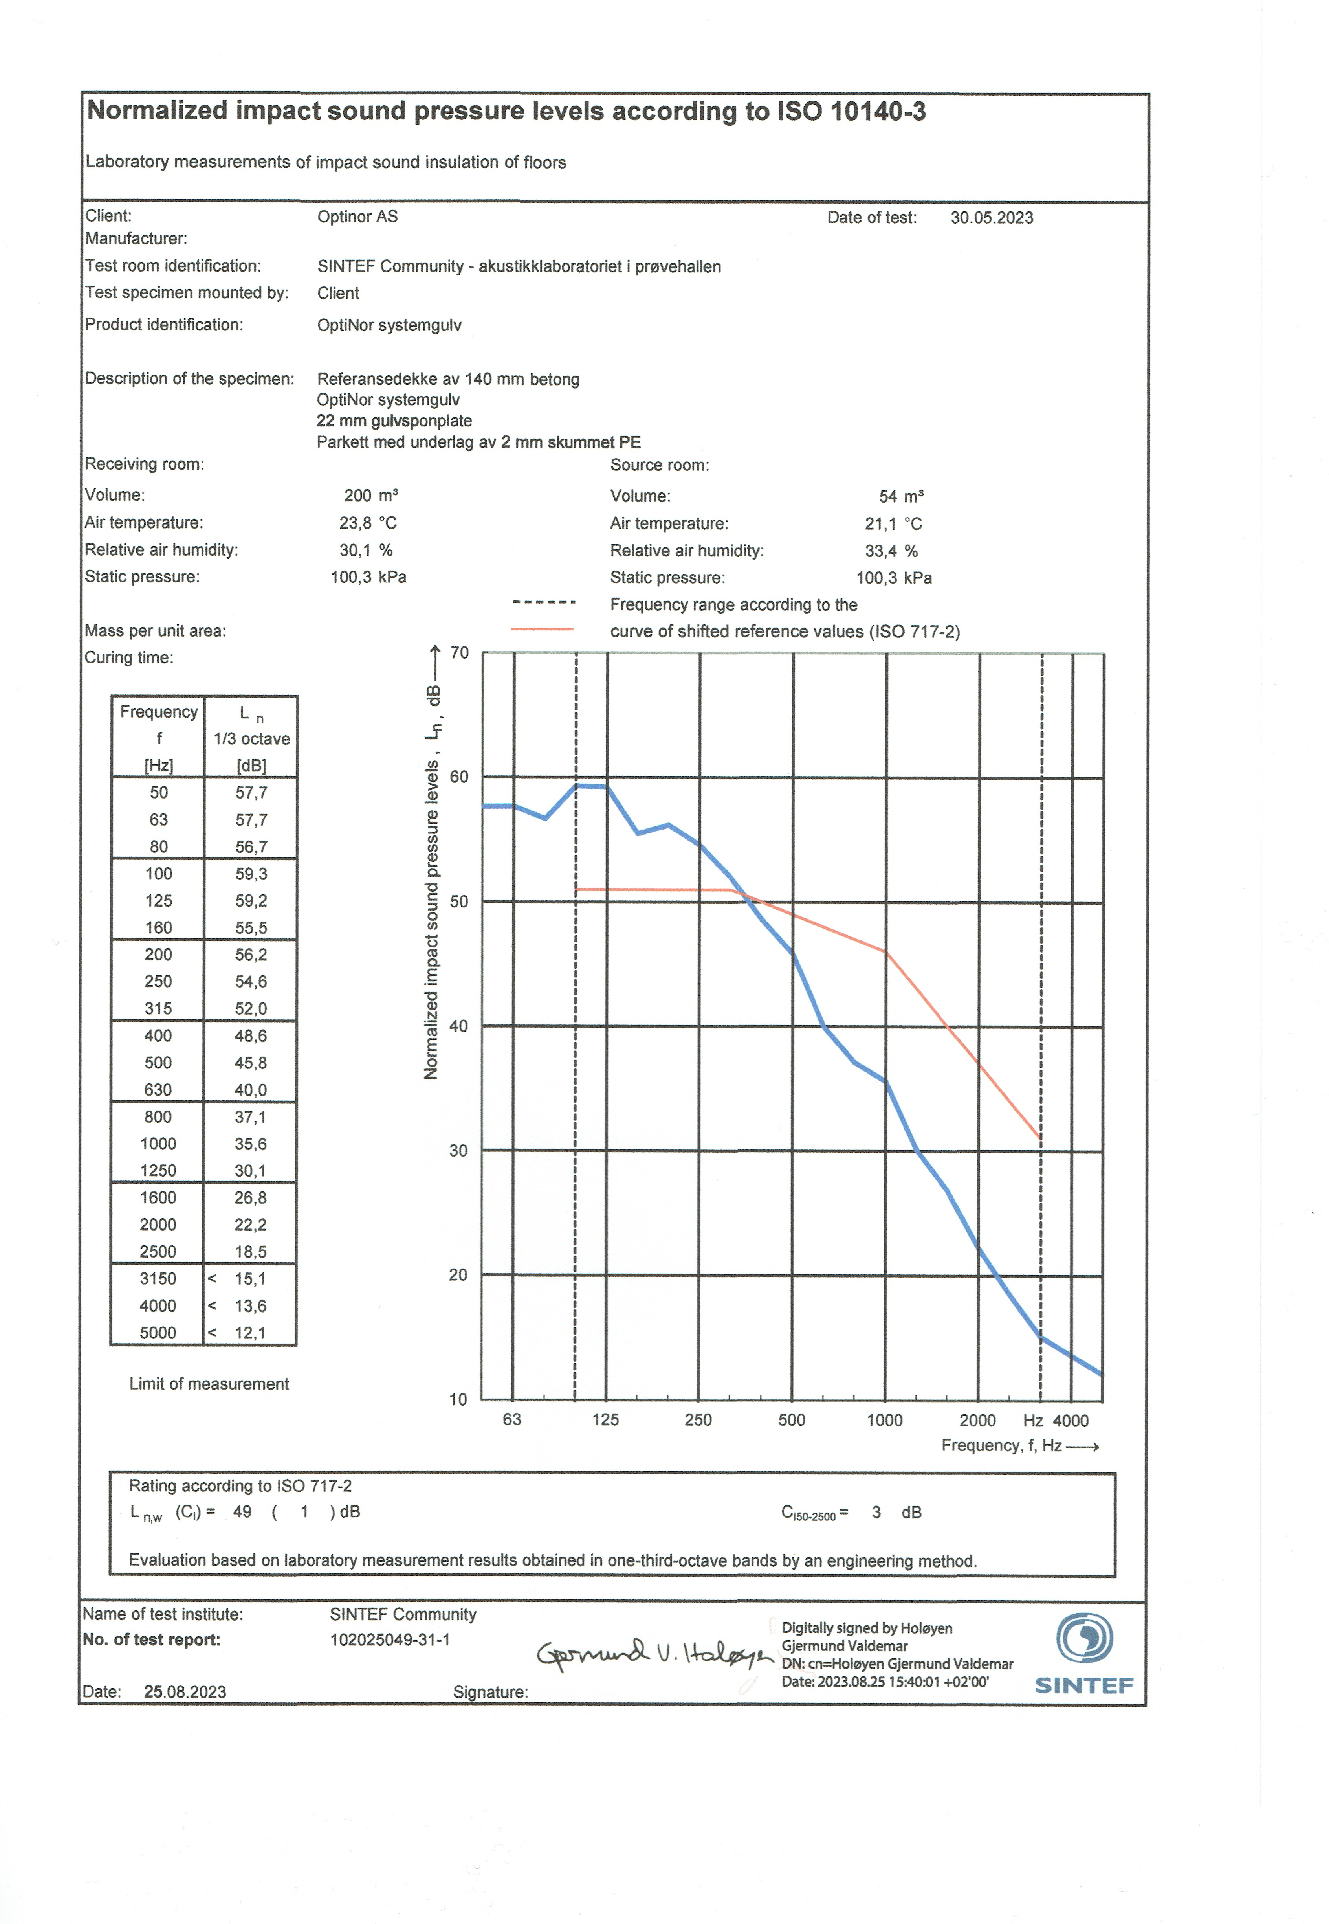
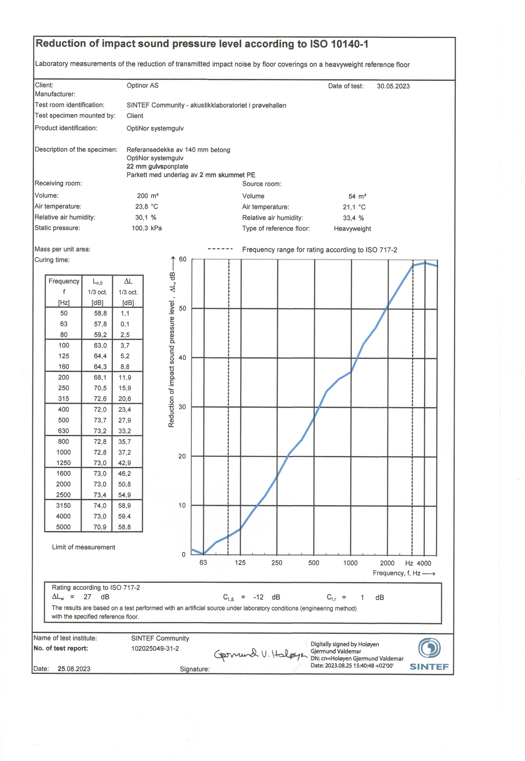
OptiNor
Sound-reducing Floor System
Test winner

Slide 8
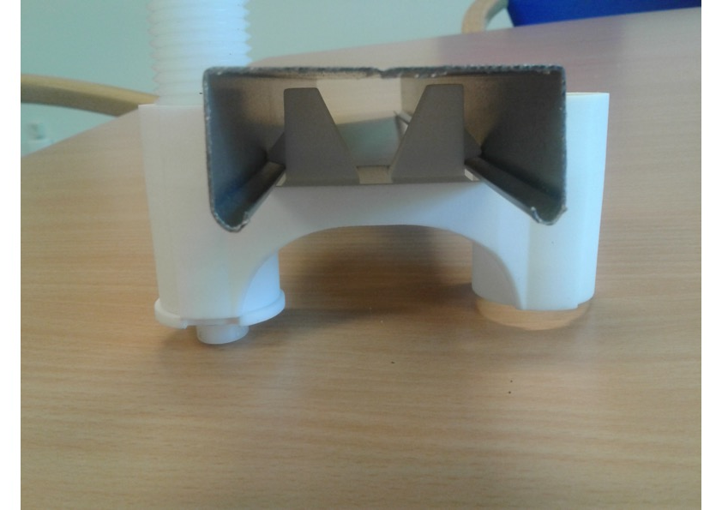
OptiNor
Sound-reducing Floor System
Best in installation
Adjustable CC distance – the only one on the market!
Adapted for double sound screws, which provides greater load capacity!
No screw/bolt fastening required gives no sound transmission!

Slide 9
OptiNor
Sound-reducing Floor System
Additional info
The joist of the system is the same as in Norgips' ceiling system.
This results in a doubling of sales for Norgips in projects.
I am constantly working on developing the system to maximize its qualities.
This includes;
Screw extender with total height up to 50cm
Low-voltage heating base for parquet flooring and cold bridge stops

Slide 10
OptiNor
Sound-reducing Floor System
Thanks for your attention, in the hope of good future cooperation!
Best regards
Dag J. Søndbø
Inventor / License holder
OptiNor AS

